Slide 1
DOOR LOCK SYSTEM
2127004 - Sneha Sanjaykumar Bhaskar
2127012 - Rohit Vikas Dhotre
2127014 - Akash Vijay Gadade
2127017 - Shubham Vilas Gaikwad
2127033 - Harshada Narayan Khuspe

Slide 2
CONTENT
Introduction
Need of topic
Components
Component Information
Use Case Diagram
Code
Applications
Conclusion
References

Slide 3
INTRODUCTION
smart lock
A smart lock is an electronic and mechanical locking device that opens wirelessly with an authorized users’ authentication.

Slide 4
NEED OF TOPIC
1 . To Increase Accessibility Without
Compromising Security .
2 . Simplify Home Security .
3 . To have So Many Options to Lock and
Unlock Your Property .

Slide 5
COMPONENTS

Slide 6
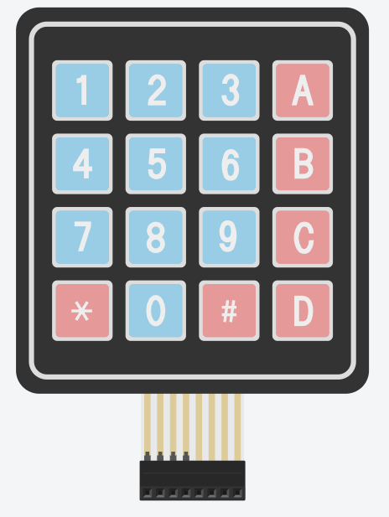
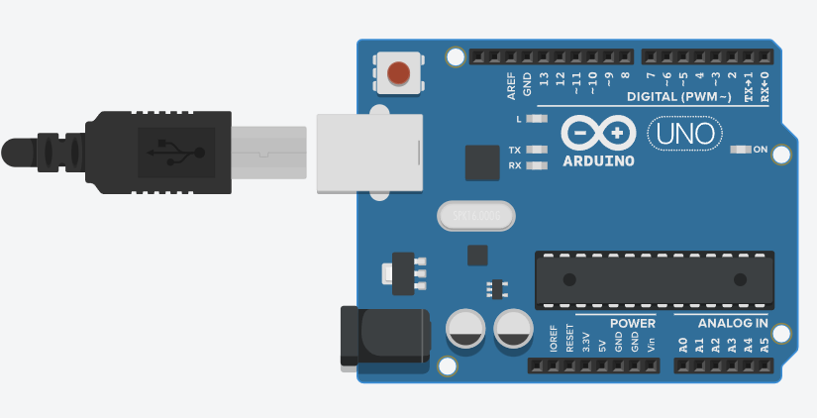
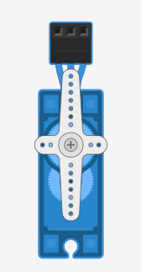
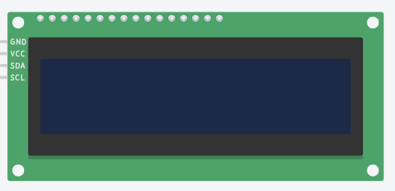
Arduino Uno
Micro Servo
Keypad 4 x 4
LCD 16 x 2 (I2C)

Slide 7
COMPONENT INFORMATION

Slide 8
Arduino Uno
The Arduino Uno is an open-source microcontroller board based on the Microchip ATmega328P microcontroller and developed by Arduino.cc. The board is equipped with sets of digital and analog input/output (I/O) pins

Slide 9
LCD 16×2
An electronic device that is used to display data and the message is known as LCD 16×2. As the name suggests, it includes 16 Columns & 2 Rows so it can display 32 characters (16×2=32)

Slide 10
Micro Servo
Micro Servo Motor SG90 is a tiny and lightweight server motor with high output power. Servo can rotate approximately 180 degrees (90 in each direction)

Slide 11
Keypad 4 x 4
The 4x4 matrix keypad is a simple mechanism that resembles the numeric input on your computer keyboard, except that it has an additional '*,' '#' and 4 other auxiliary buttons that can be used for various functions in the application.

Slide 12
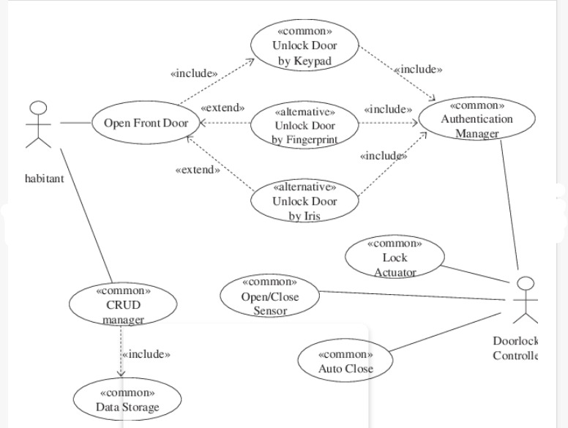
USE CASE DIAGRAM

Slide 13
CIRCUIT

Slide 14
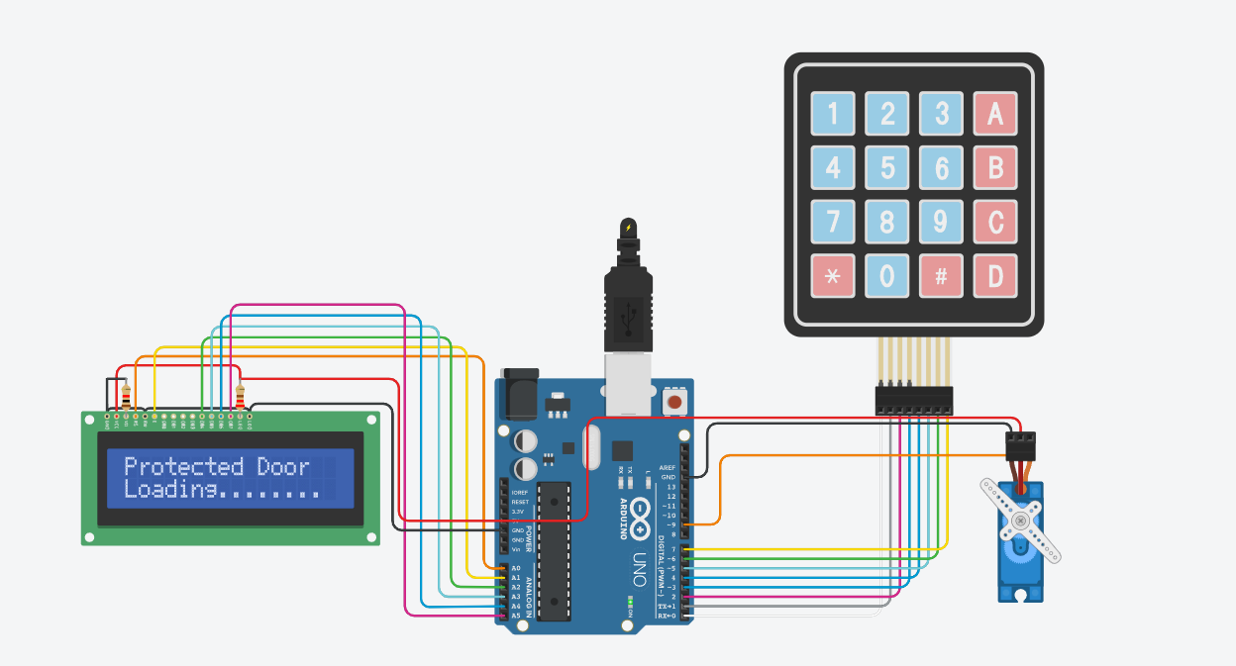

Slide 15
CODE

Slide 16
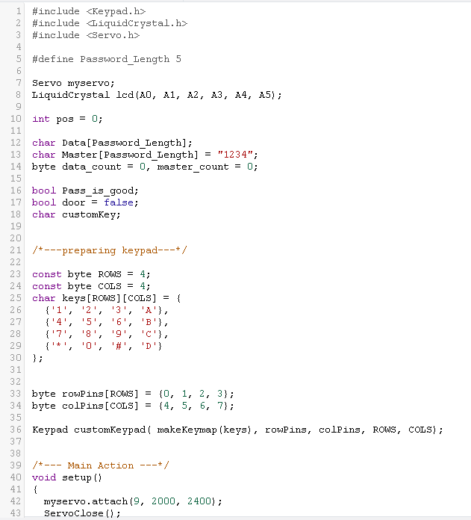
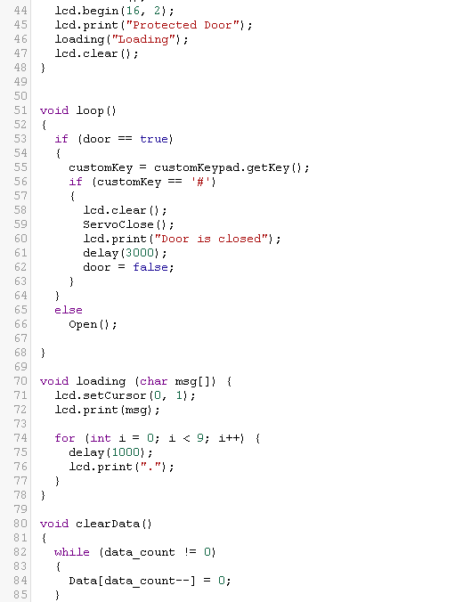

Slide 17
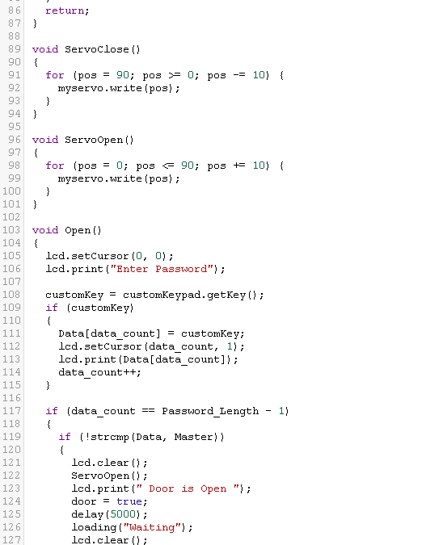
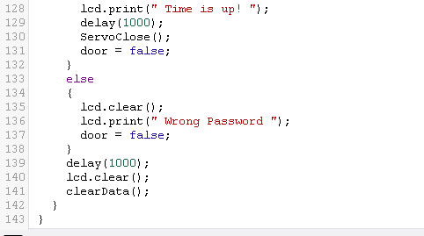

Slide 18
APPLICATIONS
Convenient for Elderly and Physically Impaired People
Ensures You a High Security
It Detects Your Presence
Send e Keys to Your Near and Dear Ones
You simply need a smartphone for that

Slide 19
CONCLUSION
Smart home locks definitely offer some perks like security and convenience, but you also need to understand fully the potential issues it comes with before going ahead and installing them.

Slide 20
REFERENCES
https://www.tinkercad.com/
https://youtu.be/-s2QgXVrSXc
https://youtu.be/-s2QgXVrSXc
https://create.arduino.cc/projecthub/arun8/iot-smart-door-simplest-method-c6c7ca
https://iotdesignpro.com/projects/fingerprint-door-lock-system-using-arduino-and-smartphone

Slide 21
THANK YOU

